Slide 1
Resolution in the Propositional Calculus

Slide 2
Outline
A New Rule of Inference: Resolution
Converting Arbitrary wffs to Conjunctions of Clauses
Resolution Refutations
Resolution Refutation Search Strategies

Slide 3


A New Rule of Inference: Resolution
Literal: either an atom (positive literal) or the negation of an atom (negative literal).
Ex: Clause is wff
(equivalent to )
Ex: Empty clause { } is equivalent to F

Slide 4
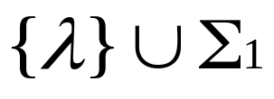
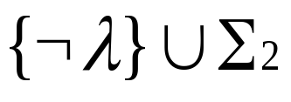

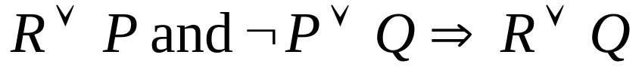

Resolution on Clauses (1)
From and, we can infer
  called the resolvent of the two clauses
  this process is called resolution
Examples
  : chaining
  : modus ponens

Slide 5
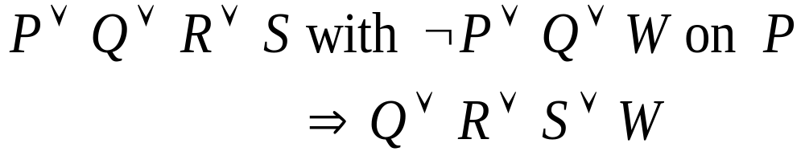
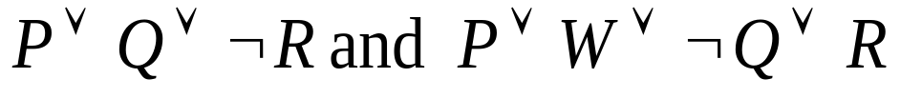




Resolution on Clauses (2)
    Resolving them on Q :
    Resolving them on R :
    Since are True, the value of each of these resolvents is True.
    We must resolve either on Q or on R.
    is not a resolvent of two clauses.

Slide 6





Soundness of Resolution
If and both have true, is true.
Proof : reasoning by cases
  Case 1
    If is True, must True in order for to be True.
  Case 2
    If is False, must True in order for to be True.
  Either or must have value True.
  has value True.

Slide 7





Converting Arbitrary wffs to Conjunctions of Clauses
Ex:
  Equivalent Form Using ∨
  DeMorgan
  Distributive Rule
  Associative Rule
Usually expressed as
{(
P
∨
¬
R
),
(
¬
Q
∨
¬
R
∨
P
)}

Slide 8
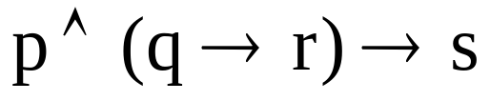
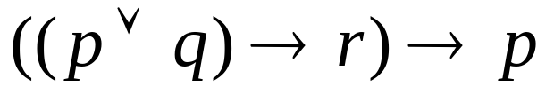
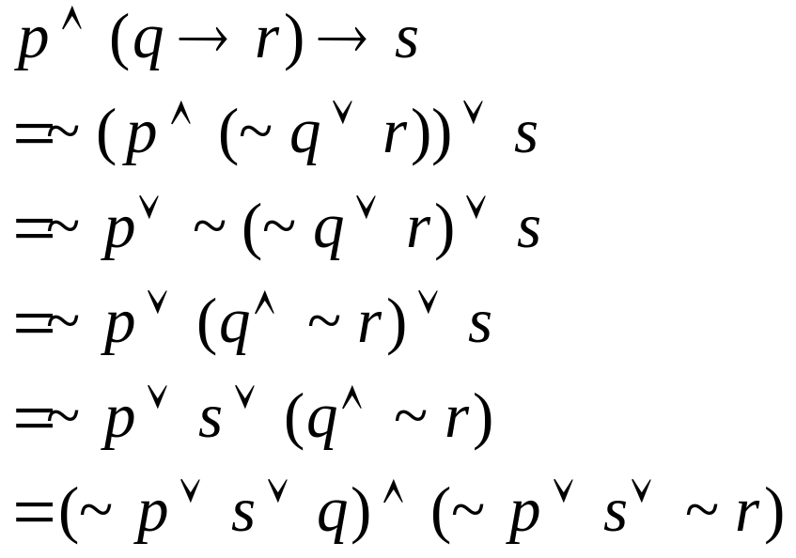
Converting wffs to Conjunctions of Clauses
Ex. Convert the following wffs to conjunctions of clauses

Slide 9



Resolution Refutations
Resolution is not complete.
  For example,
  We cannot infer using resolution on the set of clauses (because there is nothing that can be resolved)
We cannot use resolution directly to decide all logical entailments.

Slide 10


Resolution Refutation Procedure
Convert the wffs in Δ to clause form, i.e. a (conjunctive) set of clauses.
Convert the negation of the wff to be proved, , to clause form.
Combine the clauses resulting from steps 1 and 2 into a single set,
Iteratively apply resolution to the clauses in and add the results to either until there are no more resolvents that can be added or until the empty clause is produced.

Slide 11



Completeness of Resolution Refutation
Completeness of resolution refutation
  The empty clause will be produced by the resolution refutation procedure if .
  Thus, we say that propositional resolution is refutation complete.
Decidability of propositional calculus by resolution refutation
  If is a finite set of clauses and if ,
  Then the resolution refutation procedure will terminate without producing the empty clause.

Slide 12
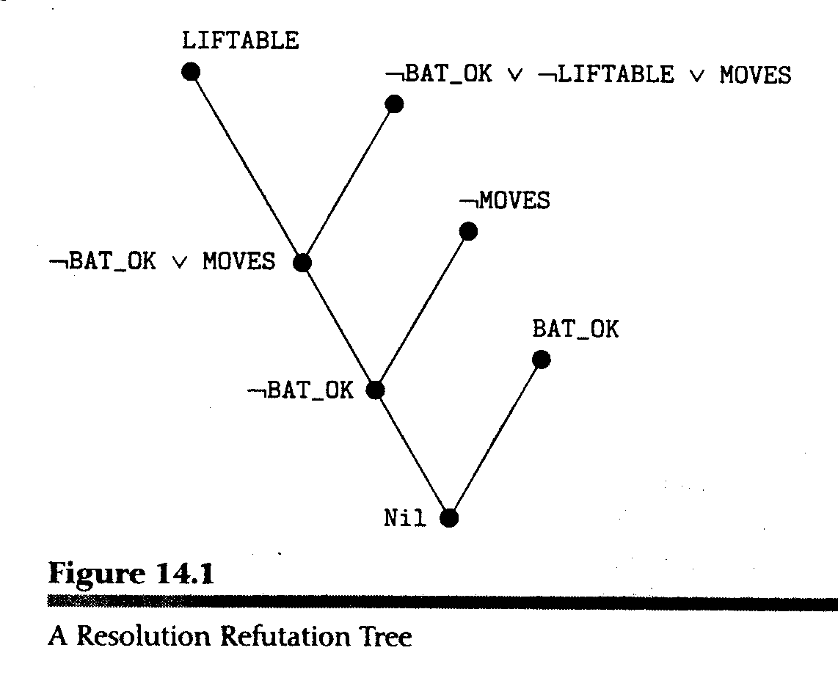

A Resolution Refutation Tree
Given:
1. BAT_OK
2. ¬MOVES
3. BAT_OK ∧ LIFTABLE
⊃ MOVES
Clause form of 3:
4. ¬BAT_OK ∨ ¬ LIFTABLE
∨ MOVES
Negation of goal:
5. LIFTABLE
Perform resolution:
6. BAT_OK ∨ MOVES
(from resolving 5 with 4)
7. BAT_OK (from 6, 2)
8. Nil (from 7, 1)

Slide 13
Resolution Refutations Search Strategies
Ordering strategies
  Breadth-first strategy
  Depth-first strategy
    with a depth bound, use backtracking.
  Unit-preference strategy
    prefer resolutions in which at least one clause is a unit clause.
Refinement strategies
  Set of support
  Linear input
  Ancestry filtering

Slide 14
Refinement Strategies
Set of support strategy
  Allows only those resolutions in which one of the clauses being resolved is in the set of support, i.e., those clauses that are either clauses coming from the negation of the theorem to be proved or descendants of those clauses.
  Refutation complete
Linear input strategy
  at least one of the clauses being resolved is a member of the original set of clauses.
  Not refutation complete
Ancestry filtering strategy
  at least one member of the clauses being resolved either is a member of the original set of clauses or is an ancestor of the other clause being resolved.
  Refutation complete

